Slide 1
Improving Survival to Discharge following Out of Hospital Cardiac Arrest
May 2016

Slide 2
YAS Cardiac Arrest Annual Report 2015
Resuscitation attempted on 2,970 patients (nationally: 28,000)
Return Of Spontaneous Circulation in 22.6% (nationally: 25%)
Survival to Discharge for all cardiac arrests was 10.6% (nationally: 7-8%)
281 patients were discharged from hospital alive
Notes:
Bystsnder CPR rate in Norway is 73%, S2D is 25% (Emerg Med J doi:10.1136/emermed-2015-204847)

Slide 3
National strategy
Cardiovascular Disease Outcomes Strategy for England (2013)
Increase Survival to Discharge from Out of Hospital Cardiac Arrest by 50%
= 1,000 lives saved per year
Notes:
YAS committed to increasing S2D by 10% by 2020.

Slide 4
YAS findings
>62% of patients were >65 years old
Peak occurrences:
January
Saturday
Between 08:00hr and 09:00hr
Wide variation in Survival to Discharge rates
Notes:
38% were <65 years old

Slide 5
18.6% of patients presented with a shockable rhythm, i.e. amenable to defibrillation
Bystander CPR performed on 49.6% (Norway: 73%)
Notes:
YAS has committed to increasing bystander CPR from 43% to >60% by 2020
Norway’s S2D is 25% Emerg Med J doi:10.1136/emermed-2015-204847

Slide 6
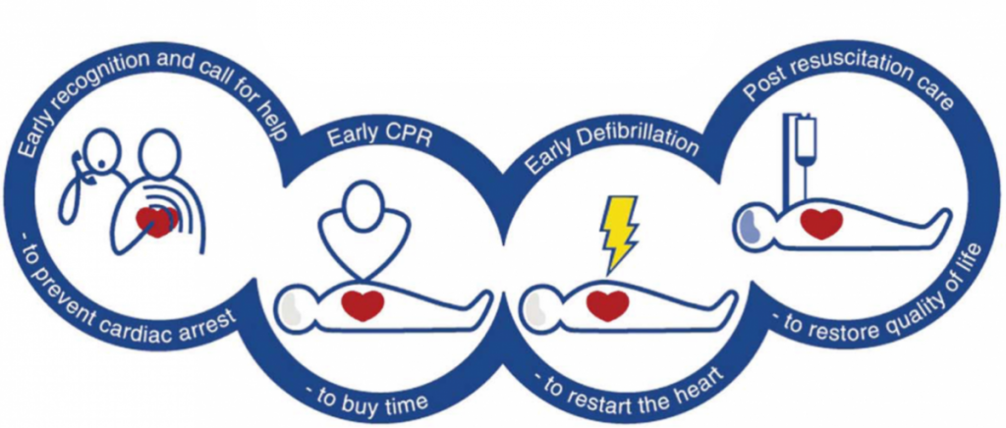
Chain of Survival
Notes:
Early CPR can improve S2D by up to 4-fold
Defibrillation within 3-5 minutes can produce S2D of 50-70%
Standardised post-resuscitation care

Slide 7
Early CPR
‘Heartstart’ - 2013 - European Resuscitation Council
‘Lifesaver’ DVD to all secondary schools
Primary aims:
teach skills required to save a life
improve bystander CPR rates

Slide 8
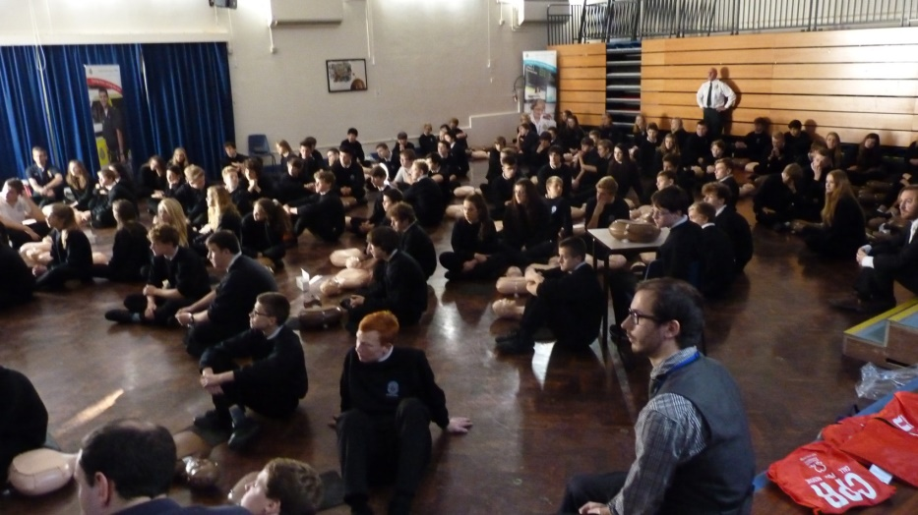
Restart a Heart day 2014
Visited approx. 50 schools
Taught 11,500 students CPR in a day
>200 clinical staff and CFR volunteers
BHF provided manikins through launch of Nation of Lifesavers campaign

Slide 9
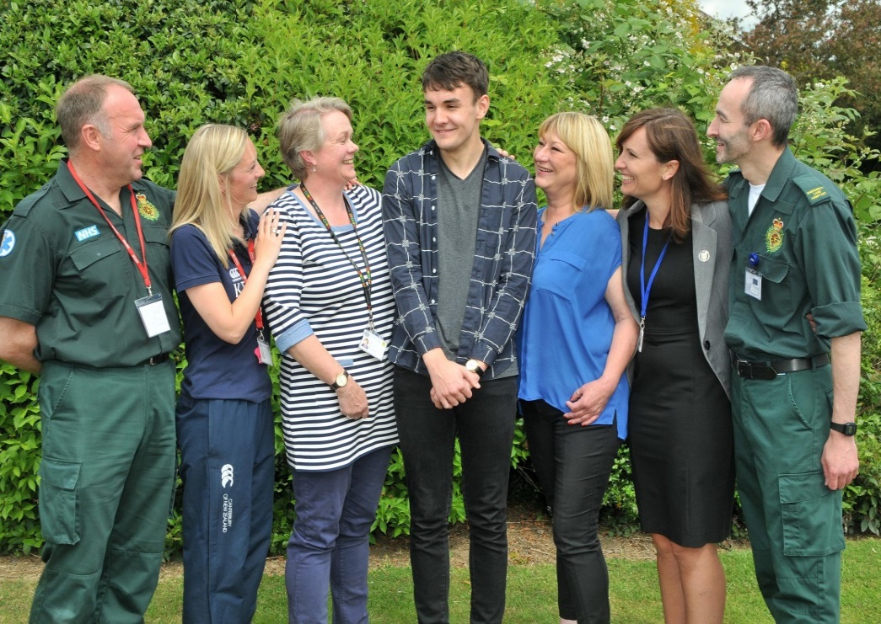
Why do it again?

Slide 10
Restart a Heart day 2015
88 Schools visited
>20,000 children taught
>400 volunteers from clinical and non-clinical staff, St John Ambulance, Community First Responders, Resuscitation training departments, Fire & Rescue Service

Slide 11
129 schools registered across Yorkshire
267 volunteers already registered
Target to beat last year’s figure
projection ~25,000
Partnership working

Slide 12
Spreading best practice
Formed National Strategic Committee with RC(UK) , BHF, BRC, SJA
March 2016 - Presented to Association of Ambulance Chief Executives
April 2016 - Presented to All Party Political Group at Westminster
Notes:
YAS was held up as an exemplar of best practice. Model shared and all planning/documents shared essentially providing each service with the toolkit to follow our model.

Slide 13
National Restart a Heart day
Commitment from all English ambulance trusts
April 2016 - Hosted webinar to share best practice
Aim – to train as many young people as possible on that day in CPR
Target >100,000

Slide 14
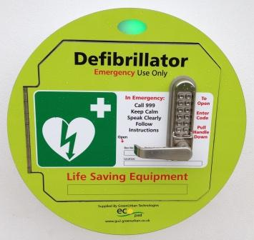
Early defibrillation
PAD sites | March 2015 | March 2016 | Increase
ABL | 44 | 102 | 58
CKW | 6 | 34 | 28
Hull & ER | 54 | 109 | 55
NY | 93 | 202 | 109
SY | 15 | 34 | 19
Total | 212 | 481 | 269 (127%)

Slide 15
Post-resuscitation care
Inotrope support
Low dose adrenaline to support blood pressure
Synchronised DC cardioversion
To treat life-threatening tachyarrhythmias (fast heart rate)
External cardiac pacing
To manage life-threatening bradyarrhythmias (low heart rate)

Slide 16
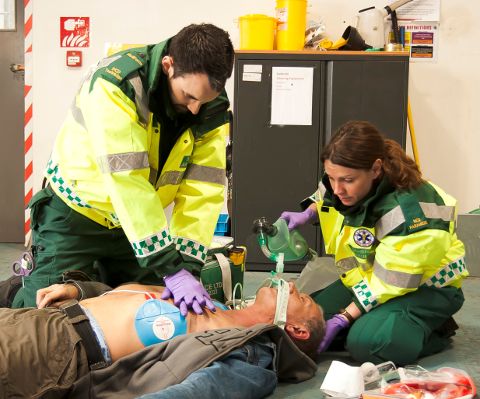
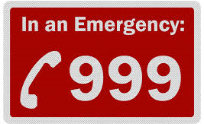
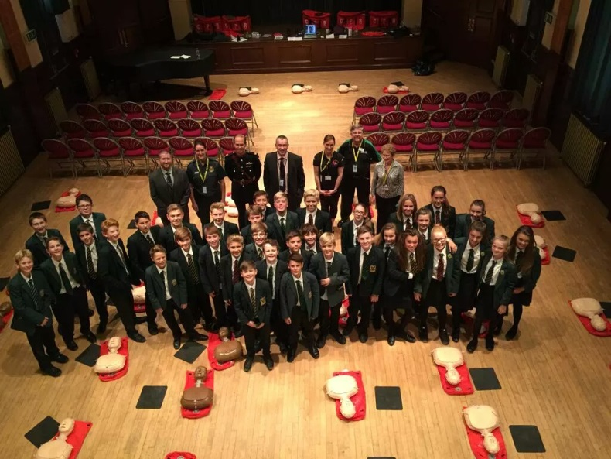
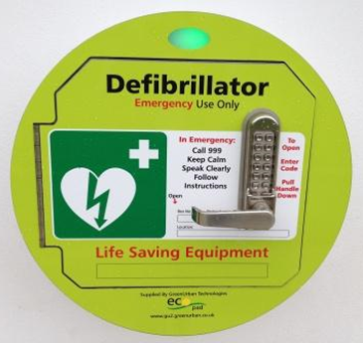
Questions

